Slide 1

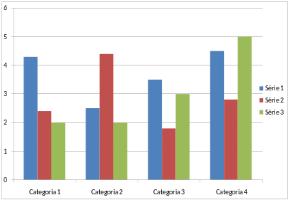

TOPIC (E.J. INDUSTRIAL ENZYMOLOGY)
TITLE OF THE WORK IN CAPITAL LETTERS: FONT ARIAL, BOLD, SIZE 11 (MAY BE REDUCED TO 10 IF THE TITLE IS LONGER)
Author 1, Author 2, Author 3, Author 4 and Author 5 (SURNAME, N. format)
Research Origin Institution(s)
FONT ARIAL, SIZE 9
INTRODUCTION
The arrangement of the texts represented in the space of the TITLE OF THE WORK and the AUTHOR’S NAME is mandatory. In the “TOPIC” space, authors must enter the area where the work was approved; formatting in this space is also mandatory. For other spaces after the INTRODUCTION, formatting is optional. We suggest using the following formatting for the body of the text: Arial, size 9. And for topic titles: Arial, size 11, bold.
Works must be sent in electronic poster format (e-Poster), that is, they do not need to be printed. Follow the instructions on the website.
There is no requirement regarding the number of characters, colors or fonts. Tables, figures and graphs may be included. The title of any graphic element can be placed below it.
Item | Variable 1 (unit) | Variable 2 (unit)
X | -0.220 | 0.443
Y | 0.500 | 0.385
Z | 0.251 | 0.444
METHODOLOGY
Table 1: Table title
Authors can insert texts, figures, graphs and diagrams to present the methodology used in the work.
Works must be written in English and be associated with one of the six thematic axes chosen at the time of submission.
We suggest using direct and succinct language to better present the methodology.
CONCLUSIONS
The main conclusions regarding the research must be presented on this topic.
ACKNOWLEDGMENTS
People, grants, funds, and other entities should be acknowledged in this topic with full-written names in one paragraph.
RESULTS AND DISCUSSION
The content of approved slides or posters must be in English, but presentations will be made in Portuguese. The e-poster must be sent to email (cobbind@contato.ufsc.br) by August 23th 2024, with no extension period. Submission must be made in PDF format. Save your file as: ID abstract number_Presenter’s surname.pdf.
REFERENCES
References may be cited in the text with Arabic numbers between square brackets "[ ]“. “As the properties of supports strongly affect the catalytic performance of immobilized enzymes, the design and preparation of support materials has been the focus of several recent studies. [1]”. Listed references must include the surname and initials of all the authors separated by comma, followed by year of the publication (between parenthesis) and DOI.
[1] DU, M., LIU, J., WANG, Q., et al. (2025). DOI: https://doi.org/10.1016/j.jes.2023.10.017
[2] ZHANG, Z., GAO, L., BOES, A. (2024) et al. DOI: https://doi.org/10.1038/s41467-024-47007-y
Or, if you prefer, instead of the listed references, you can add a QRcode that takes you to a file with the references used in the banner. There is a template you can scan:
Figure 1: Figure title

