Slide 1

TITLE OF THE WORK IN CAPITAL LETTERS: FONT APTOS LIGHT, BOLD, SIZE 28
Author 1, Author 2, Author 3, Author 4 and Author 5 (SURNAME, N. format)
Research Origin Institution(s)
FONT APTOS LIGHT, SIZE 20

Slide 2

General Instructions
Presentation time: 5 minutes
  Please plan your presentation to ensure it stays within the designated time limit!!!
Questions & Answers will be addressed at the end of 5-presentation block.
List of oral presentations can be assessed here:
https://cobbind.com.br/evento/cobbind2024/trabalhosaprovados
The speaker must prepare the presentation using slides (PowerPoint) and go to the Media Desk to save the file in the system at least 1 hour before the session start.
The presenting author must use the event's standard slide to prepare the presentation, which must contain: Introduction, Material and Methods, Results/Discussion, Conclusion. Figures, tables and graphs are welcome.

Slide 3
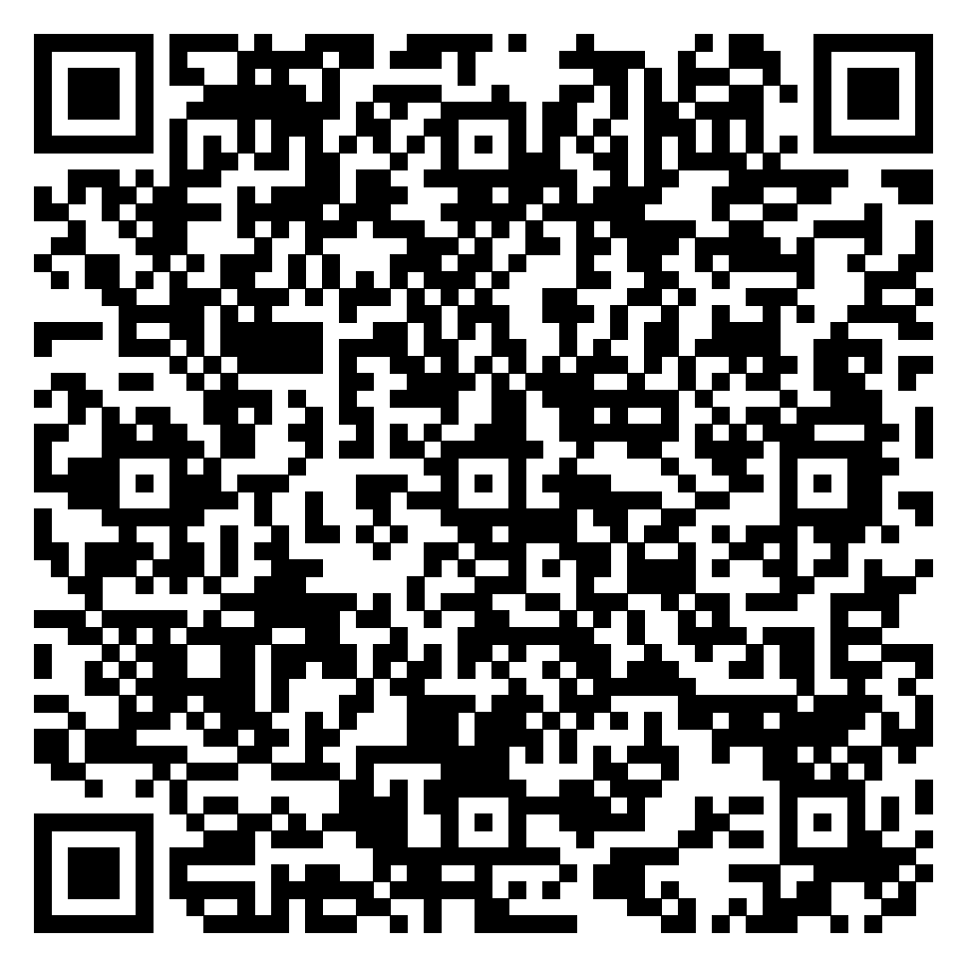
References
References may be cited in the text with Arabic numbers between square brackets "[ ]“.
“As the properties of supports strongly affect the catalytic performance of immobilized enzymes, the design and preparation of support materials has been the focus of several recent studies. [1]”.
Listed references must include the surname and initials of all the authors separated by comma, followed by year of the publication and DOI.
[1] DU, M., LIU, J., WANG, Q., et al. (2025). DOI: https://doi.org/10.1016/j.jes.2023.10.017
[2] ZHANG, Z., GAO, L., BOES, A. et al., (2024). DOI: https://doi.org/10.1038/s41467-024-47007-y
Or, if you prefer, instead of the listed references, you can add a QRcode that takes you to a file with the references used in the banner. There is a template you can scan:

Slide 4

Thank you!
Contact for any information:
cobbind@contato.ufsc.br

