Slide 1

INTERPROFESSIONAL SCIENTIFIC PUBLISHING
Working Together in Practice
Opportunities and friction points when physicians, pharmacists, and nurses / nurse practitioners co-author scholarly work.
Maritza Alencar, DNP, MBA, APRN-BC, TCTCN, FAANP
Clinical Assistant Professor, Florida International University Nicole Wertheim College of Nursing
Associate Editor, Supportive Care Dept., Clinical Journal of Oncology Nursing
Notes:
Welcome and quick introduction. Frame today as practical scientific publishing: what actually happens when physicians, pharmacists, and nurses or nurse practitioners try to write together. Emphasize that the goal is not a literature review of publishing — it is the opportunities and friction points I have seen first-hand. Set expectations: about 15 minutes, with three short examples from my own scholarship.

Slide 2

ROADMAP
Agenda
1
Publishing landscape today
5
Common challenges
Volume, multidisciplinary share, and team-science growth.
Priorities, time, writing experience, authorship.
2
Why this matters
6
A simple workflow
Publishing shapes practice, education, and policy.
From question to submission.
3
Authorship essentials
7
Examples from my work
ICMJE criteria — credit and responsibility.
CAR-T, transplant TMA, zoster vaccine, NP fellowship, ASTCT guidelines.
4
What each discipline brings
8
Practical takeaways
Physicians, pharmacists, nurses and NPs.
What to do on Monday morning.
2 / 18
Notes:
Quick roadmap. I will open with a brief snapshot of where scientific publishing sits today, then frame why interprofessional publishing matters, walk through what each discipline brings, name the most common challenges, share a simple workflow, ground it all in examples from my own publications, and finish with practical takeaways you can act on.

Slide 3
DATA SNAPSHOT
The Publishing Landscape Today
A sourced snapshot of publication volume and interprofessional collaboration trends.
3.3M
109
6,694
Worldwide S&E articles in 2023
Primary-care collaboration studies reviewed
IPC health-sciences records mapped
Scopus-indexed science and engineering publication output (NCSES/NSF).
Teams averaged 4.5 disciplines; nurses appeared in 72% of articles (Saint-Pierre et al., 2018).
Bibliometric review of interprofessional collaboration; sharp increase after 2015 (Terlemez).
KEY TREND
Publication volume continues to expand, while health-sciences literature shows growing attention to interprofessional collaboration and team-based research.
Sources: NCSES/NSF; Saint-Pierre et al., Family Practice (2018); Terlemez (2026).
3 / 18
Notes:
Let’s set the stage. The volume of scientific publishing continues to grow, and the trend toward multidisciplinary research is accelerating. Healthcare’s most impactful studies often come from teams that bring multiple clinical lenses to complex problems.

Slide 4
FRAMING
Why This Matters
Practice
Education
Policy
Published evidence changes what clinicians actually do at the bedside and in clinic.
Curricula, fellowships, and competencies are built from the literature each discipline produces.
Guidelines, formularies, and scope of practice decisions cite peer-reviewed work.
Interdisciplinary work is clinically useful
Patients do not experience care as a single discipline. When we write together, our evidence reflects how care is actually delivered — and is more likely to be adopted across roles.
4 / 18
Notes:
Publishing is not just an academic exercise. It directly influences three things: what clinicians do, how trainees are taught, and how policy is written. Because patients experience care across disciplines, interdisciplinary publishing produces evidence that more closely matches how care is actually delivered — and that evidence is more readily adopted by every role on the team.

Slide 5
ICMJE IN PLAIN LANGUAGE
Authorship Essentials – Int’l Committee of Medical Journal Editors
Authorship grants both credit and responsibility.
1
Substantial contribution
2
Drafting or critical revision
To conception, design, data, analysis, or interpretation.
For important intellectual content — not just edits.
3
Final approval
4
Accountability
Of the version actually submitted and published.
For the integrity and accuracy of the work as a whole.
Practical rules of the road
Four criteria must be all met to be listed as an author; contributors who do not meet all four should be acknowledged (with permission and role described).
Discuss authorship early — journals do not arbitrate disputes. AI tools cannot be authors and any AI-assisted work must be disclosed; authors remain responsible.
Source: ICMJE — Defining the Role of Authors and Contributors
5 / 18
Notes:
Before we go further, I want to ground us in the authorship framework that everyone on an interprofessional team should know: the ICMJE criteria. Authorship is not just a name on a paper — it carries both credit and responsibility. The ICMJE recommends that every author meet all four criteria: substantial contribution to the work; drafting or critical revision; final approval; and accountability for the integrity of the whole. People who contributed but do not meet all four belong in the acknowledgments, with their permission and their role described. Two practical points: authorship needs to be discussed early in the project, because journals do not arbitrate disputes after the fact — and AI tools cannot be authors. Any AI-assisted work has to be disclosed, and the human authors remain responsible.
International Committee of Medical Journal Editors

Slide 6
WHO BRINGS WHAT
Interests Across Disciplines
Physicians
Pharmacists
Nurses & NPs
Clinical relevance & outcomes
Medication safety & implementation
Feasibility, education, care delivery
Disease trajectory and treatment effect
Trial design and clinical endpoints
Generalizability across populations
Dosing, interactions, adverse events
Adherence and implementation science
Formulary and stewardship questions
Patient-reported outcomes and education
Workflow feasibility at the bedside
Care coordination across settings
Complementary, not competing — these interests reinforce each other in a single project.
6 / 18
Notes:
Each discipline tends to bring a different center of gravity. Physicians focus on clinical relevance and outcomes. Pharmacists focus on medication safety and the implementation details that determine whether a regimen actually works. Nurses and NPs focus on feasibility, patient education, and the care-delivery pieces that make the difference at the bedside. These are complementary, not competing — and a good project deliberately uses all three lenses.

Slide 7
WHERE PROJECTS STALL
Common Challenges
Different priorities
Uneven writing experience
Each discipline sees the "main question" through its own lens. Align on the question first.
Co-authors come in with very different exposure to manuscript writing and revision.
Time limitations
Authorship disputes
Clinical workloads compete with drafting. Realistic timelines matter more than ambitious ones.
Most conflicts come from unspoken assumptions about order and credit, not bad intent.
Prevention beats arbitration — set expectations early.
7 / 18
Notes:
Four predictable points of friction. Different priorities, because each discipline frames the question differently. Uneven writing experience, because not everyone has had the same opportunities to publish. Time limitations, because clinical work always pushes back on writing time. And authorship disputes, which are almost always preventable. The single biggest lesson: prevention beats arbitration. Set expectations at the start.

Slide 8
FROM QUESTION TO SUBMISSION
A Simple Collaboration Workflow
Step 1
Step 2
Step 3
Step 4
Step 5
Step 6
Define the question
Choose the audience
Assign roles
Draft
Review
Submit
Clinically meaningful to every co-author.
Journal and reader profile drive scope.
Lead writer + section owners, written down.
Single working document, agreed cadence.
Substantive revisions before fine edits.
Cover letter and responses authored together.
Decide the lead writer and section owners before the first draft — not after the first disagreement.
8 / 18
Notes:
A workflow that is simple enough to actually follow. Define the question together. Choose the audience and target journal, because that shapes scope. Assign roles — one lead writer, named section owners, written down. Then draft, review, and submit as a team. The single most important decision is who is the lead writer, and who owns which section, made before drafting begins.

Slide 9
APPLYING ICMJE ON INTERPROFESSIONAL TEAMS
Authorship in Practice
CONVERSATIONS TO HAVE EARLY
AUTHOR ORDER — WHAT IT SIGNALS
Who meets all four ICMJE criteria — and who is acknowledged?
First author
Did the most of the work — design, drafting, analysis.
Middle authors
Who is the lead writer? Who owns each section?
Substantive contributions in their area of expertise.
What is the working author order, and on what basis?
Senior / last author
Conceptual leadership and overall accountability.
How will AI assistance be used and disclosed?
Corresponding author
Owns submission, revisions, and post-publication queries.
Write it down before the first draft — revisit if contributions change.
Source: ICMJE — Roles and Responsibilities
9 / 18
Notes:
Now let us move from the criteria to actually applying them on an interprofessional team. On the left are the conversations I try to have at the start of any project: who meets ICMJE authorship, who is the lead writer, what is the working author order, and how will AI assistance be handled and disclosed. On the right is how I explain author order in plain language. First author did most of the work — the design, drafting, and analysis. Middle authors made substantive contributions in their lane. Senior or last author provided conceptual leadership and takes overall accountability. The corresponding author owns submission and everything that comes after. The rule of thumb: write all of this down before the first full draft, and revisit it if contributions change along the way.

Slide 10
PART TWO
Examples from my own work
Five publications that show interprofessional collaboration in practice — across CAR-T care, transplant pharmacy, vaccine response after HCT, NP fellowship development, and HCT fellowship training guidelines.
10 / 18
Notes:
Now I want to ground this in real examples from my own scholarship. Three publications across very different clinical territories — CAR-T cell therapy, transplant pharmacy, and nurse practitioner fellowship development — that each illustrate a different facet of interprofessional publishing.

Slide 11
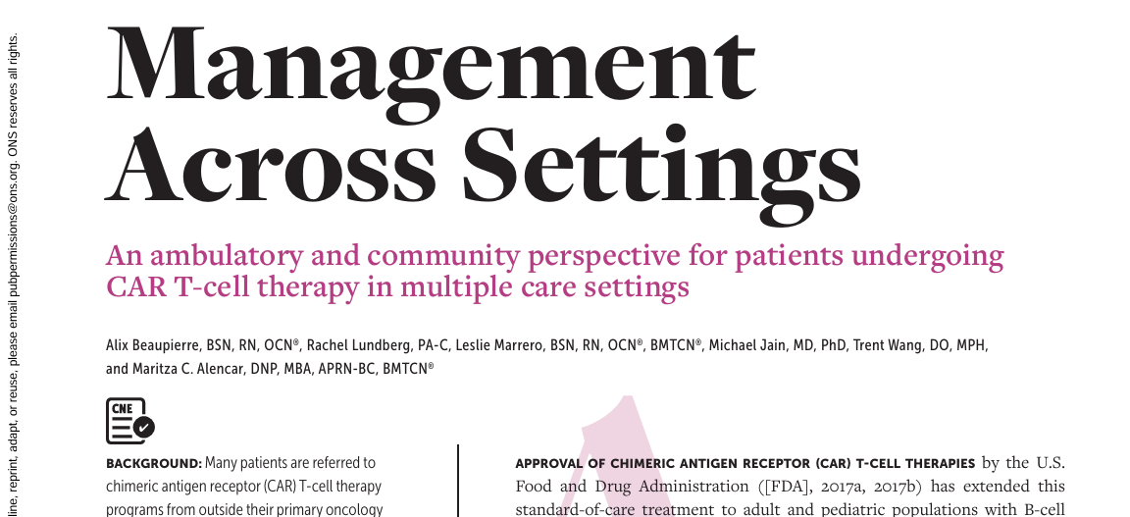
AMBULATORY & COMMUNITY PERSPECTIVE
Example 1 — CAR T-cell Therapy
Physician-led collaboration
PUBLICATION
INTERPROFESSIONAL THEMES
Coordination between referring and treating providers
Shared responsibility across settings of care
Multidisciplinary author team across nursing, APP, and physician roles
WHY IT FITS TODAY'S TALK
Physician-led, multi-setting collaboration that requires shared responsibility between teams who rarely sit in the same room.
11 / 18
Notes:
The first example is a paper on the ambulatory and community perspective for CAR T-cell patients. The authors are Beaupierre, Lundberg, Marrero, Jain, Wang, and myself — a deliberately interprofessional group with nursing, physician, and APP representation. The clinical reality is that these patients move quickly between the treating center and community providers, and care depends on coordination between teams that rarely share a chart in real time. For me, this publication illustrates what physician-led interprofessional collaboration looks like in practice — shared responsibility across settings, with each contributor bringing the lens of their own role.

Slide 12
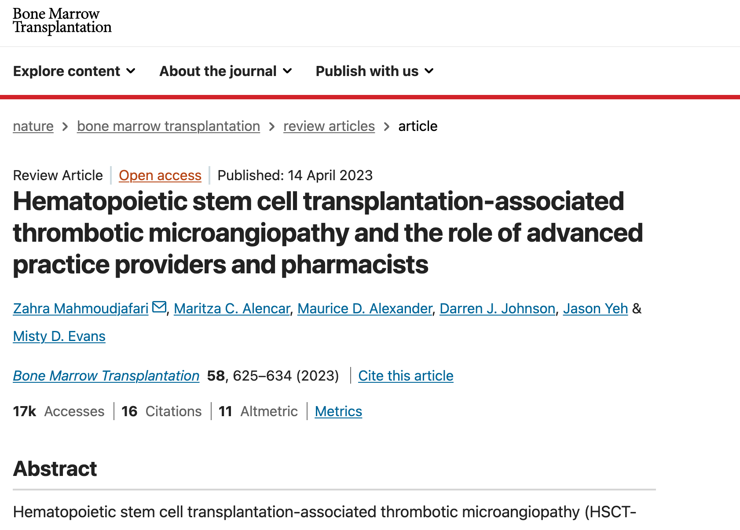
APP–PHARMACIST COLLABORATION
Example 2 — Transplant and Pharmacists
Advanced practice meets medication expertise
PUBLICATION
INTERPROFESSIONAL THEMES
Medication management and toxicity monitoring
Advanced practice decision-making at the bedside
APP and pharmacist as primary writing partners
WHY IT FITS TODAY'S TALK
Shows how APPs and pharmacists co-author when the clinical question is dominated by drug management and toxicity decisions.
12 / 18
Notes:
The second example sits squarely in transplant pharmacy territory: HSCT-associated thrombotic microangiopathy. The authors are Mahmoudjafari, myself, Alexander, Johnson, Yeh, and Evans — with pharmacists and advanced practice providers as the primary writing partners. The clinical decisions on this paper are dominated by medication management and toxicity monitoring, which is why that author mix was the natural fit. It is a good illustration of how the writing team should be chosen to match where the clinical decisions actually live.

Slide 13
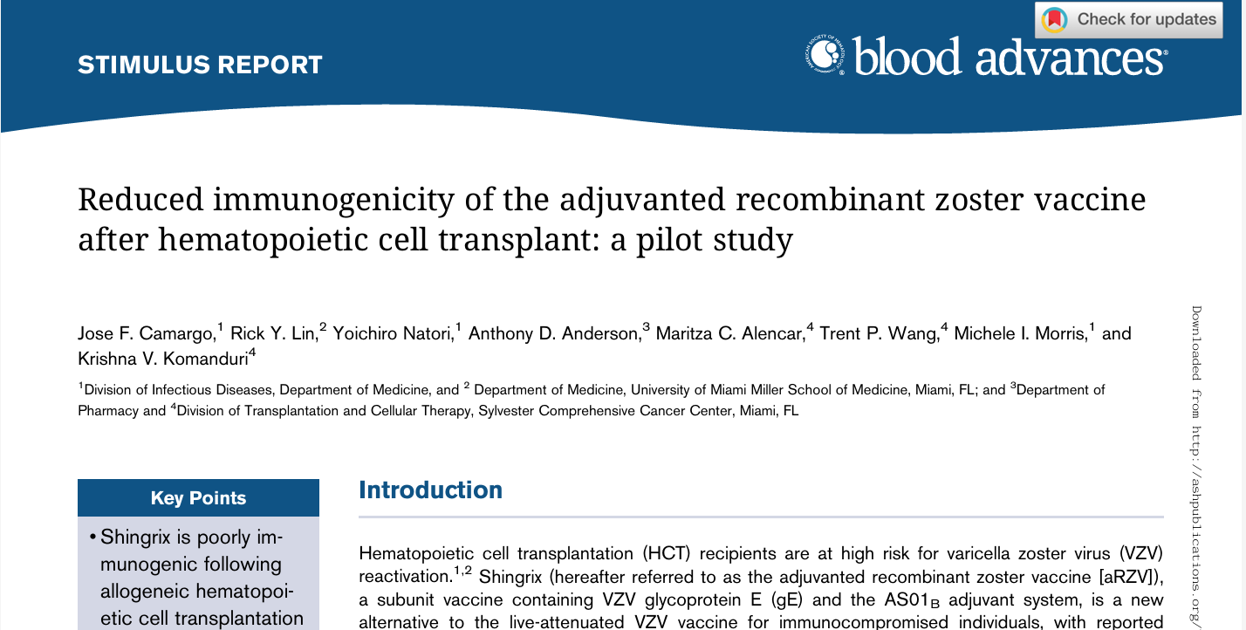
TRANSPLANT, INFECTIOUS DISEASE & ONCOLOGY
Example 3 — Zoster Vaccine After HCT
Transplant, infectious disease, and oncology co-authorship
PUBLICATION
INTERPROFESSIONAL THEMES
Transplant, infectious disease, and oncology working together
Vaccine response in an immunocompromised population
Pilot study generating signal for larger work
WHY IT FITS TODAY'S TALK
Shows how interprofessional and interspecialty co-authorship is required when a clinical question sits at the intersection of multiple fields.
13 / 18
Notes:
A fourth example that sits at the intersection of transplant, infectious disease, and oncology: a pilot study of the adjuvanted recombinant zoster vaccine after hematopoietic cell transplant. The author team — Camargo, Lin, Natori, Anderson, myself, Wang, Morris, and Komanduri — pulled together transplant, ID, and oncology investigators because the clinical question genuinely lives at their intersection. I include it as another illustration that the writing team should be assembled around where the clinical decisions live, not around a single department.

Slide 14
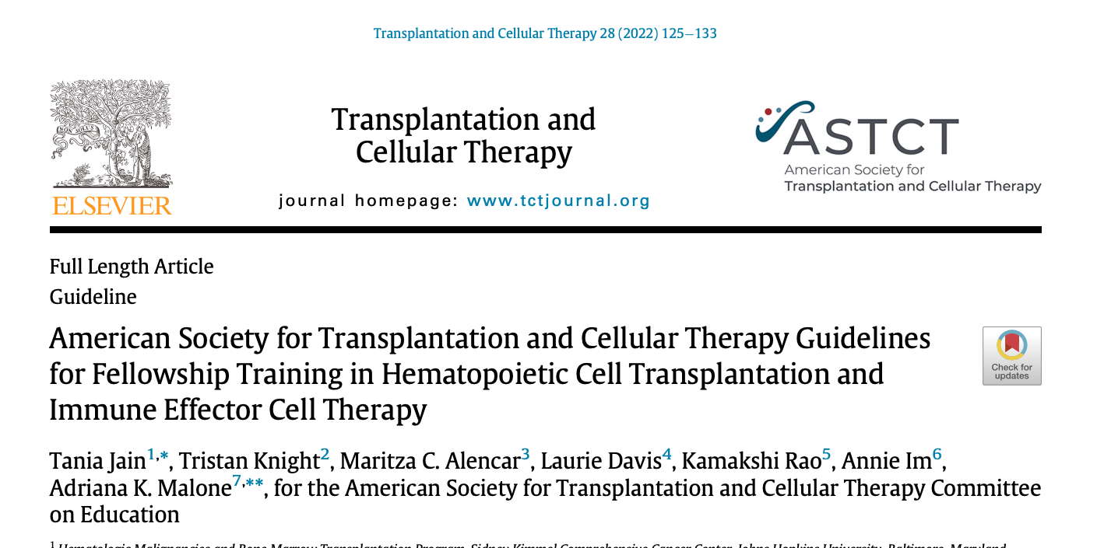
PROFESSIONAL SOCIETY TRAINING GUIDELINES
Example 4 — HCT Fellowship Training Guidelines
Society-level interprofessional education work
PUBLICATION
INTERPROFESSIONAL THEMES
Society-level scholarship shaping training standards
Multidisciplinary author team across HCT and IEC specialties
Education-focused work with workforce-wide reach
WHY IT FITS TODAY'S TALK
Illustrates how interprofessional co-authorship scales up to society guidelines that influence how every discipline is trained.
14 / 18
Notes:
A fifth example that operates at the society level rather than the project level: the ASTCT guidelines for fellowship training in hematopoietic cell transplantation and immune effector cell therapy. The author team — Jain, Knight, myself, Davis, Rao, Im, and Malone — reflects a multidisciplinary group brought together by a professional society to define competencies for the next generation of HCT and IEC clinicians. I include it to show that interprofessional co-authorship scales: the same principles that make a single-paper team work also make a society-level training document work.

Slide 15
COMMON THREADS
What Made These Projects Work
01
02
03
Clinically meaningful question
Clear roles
Regular communication
Every co-author could see why it mattered for patients.
One lead writer, named section owners, written down early.
Short, predictable check-ins beat occasional long meetings.
04
05
06
Early authorship agreement
Respect for each profession
Patient-care focus
Order and contributions agreed before the first full draft.
Every voice treated as expert in its own lane.
When in doubt, the question that helped patients won.
15/ 18
Notes:
Looking across all the examples, the same six ingredients show up. A clinically meaningful question. Clear roles. Regular communication. An early agreement about authorship and order. Respect for each profession's lane. And a relentless focus on the patient-care problem the work is trying to solve. Whenever a project of mine has gotten stuck, it has usually been because one of these six was missing.

Slide 16
PREDICTABLE FAILURE MODES
Barriers to watch for
WATCH OUT
WATCH OUT
WATCH OUT
Scope that is too broad
Delayed feedback
Late authorship discussions
A question every co-author loves often becomes a manuscript no journal wants. Narrow early.
Drafts that sit waiting on a single reviewer kill momentum. Set a turnaround norm at the start.
Talking about order at submission is the most reliable way to damage a team.
16 / 18
Notes:
Three predictable failure modes worth naming out loud. Scope that grows beyond what any journal will publish. Delayed feedback that quietly drains energy from the team. And authorship discussions that happen too late — almost always at submission, almost always painful. Name these early and you avoid most of them.

Slide 17
WHAT TO DO ON MONDAY
Practical Takeaways
01
Start with a shared purpose every co-author can name.
02
One lead writer. Section owners written down.
03
Set deadlines that respect clinical workloads.
04
Agree on authorship and order before drafting.
05
Keep communication short, frequent, and predictable.
06
Treat publishing as a team process — not a solo finish line.
Publishing is collaborative patient care — plan it like a team.
17 / 18
Notes:
Six concrete takeaways. Start with a shared purpose every co-author can articulate. One lead writer, with section owners written down. Deadlines that respect the clinical day job. Agree on authorship and order before drafting begins. Keep communication short, frequent, and predictable. And treat publishing as a team process — not a solo finish line.

Slide 18

KEY MESSAGE
Muita Obrigada!
Interdisciplinary publishing is strongest when every profession contributes its expertise, communicates early, and shares accountability.
Scholarly writing is collaborative patient care.
18/ 18
Notes:
My closing message is simple. Interdisciplinary publishing is strongest when each profession contributes its own expertise, communicates early, and shares accountability for the work. Scholarly writing, at its best, is just collaborative patient care under another name. Thank you — and I am happy to take questions.

