Slide 2
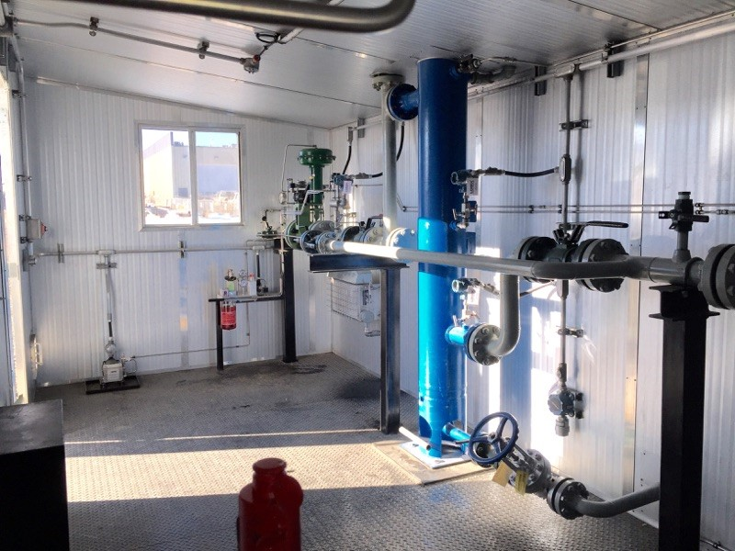
Design
Sand Filtering
Sand Separation
Electronic Flow Measurement
Build to Suit Customer Needs
Conforms to CSA, CEC and B331
Smaller Footprint
Reduced installation costs
Environmentally Friendly
Operator Friendly
LOGIX CONTROLS LTD. 12051 242Rd.
FORT ST. JOHN, BC. V1J 4M7
PHONE: (250) 785.5541
FAX: (250) 785.5591

Slide 3
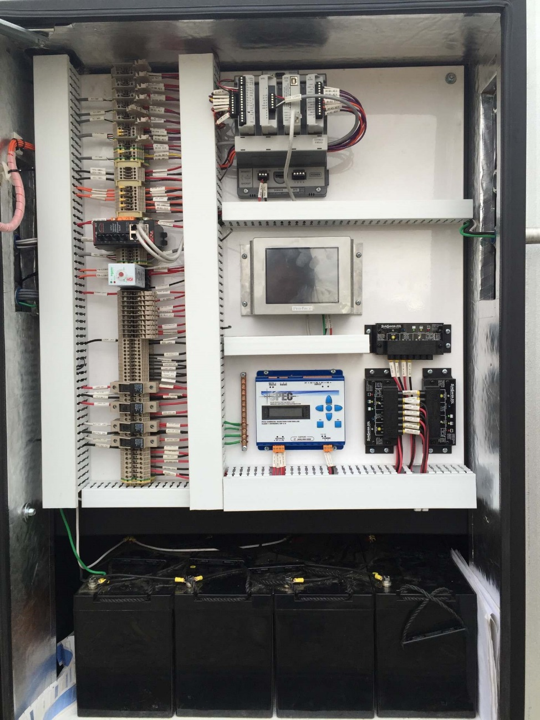
Components
Electronic Flow Measurement
Filter Differential Measurement
Actuated Choke with Positioner
Catadyne Heat
Gas Detection with Remote Display
Methanol/Corrosion Injection
LED Interior Lighting
24/12VDC Capabilities
Solar Powered
Options include:
Hydraulic ESD System
Multi Well Pad Radio Communication
TEG Backup
LOGIX CONTROLS LTD. 12051 242Rd.
FORT ST. JOHN, BC. V1J 4M7
PHONE: (250) 785.5541
FAX: (250) 785.5591

Slide 4
LOGIX CONTROLS LTD. 12051 242Rd.
FORT ST. JOHN, BC. V1J 4M7
PHONE: (250) 785.5541
FAX: (250) 785.5591

Slide 5
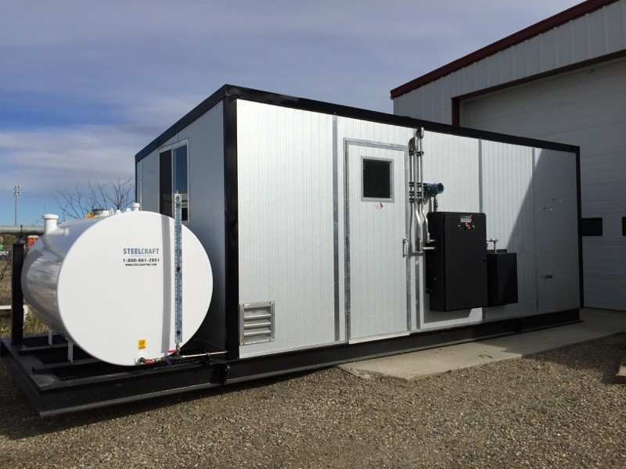
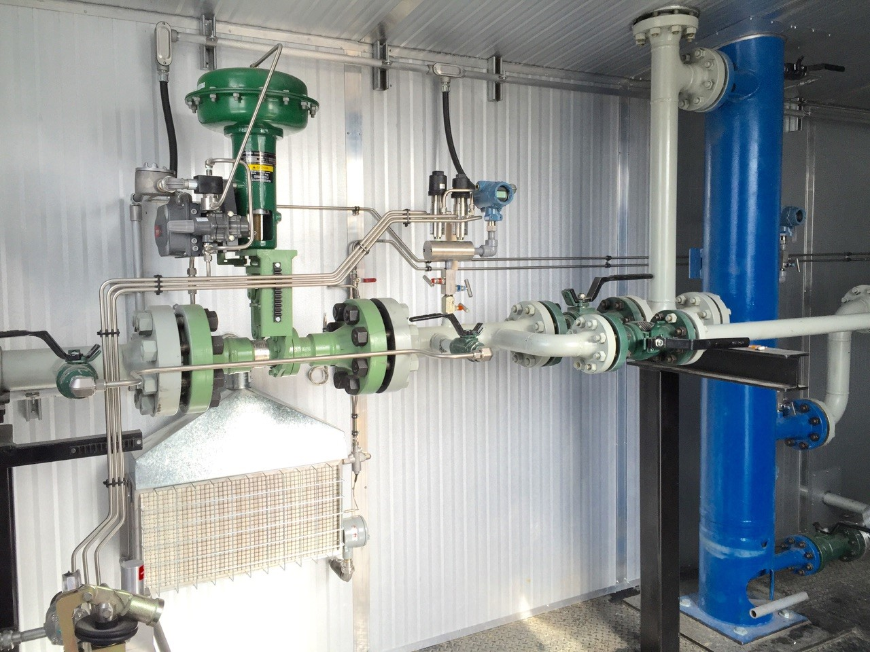
LOGIX CONTROLS LTD. 12051 242Rd.
FORT ST. JOHN, BC. V1J 4M7
PHONE: (250) 785.5541
FAX: (250) 785.5591

